Slide 1
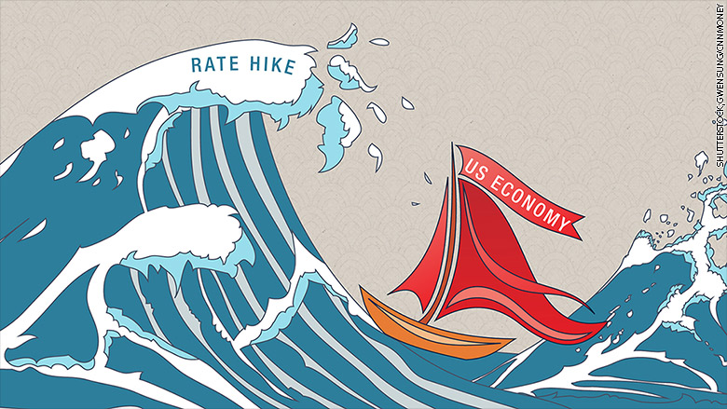

Slide 2
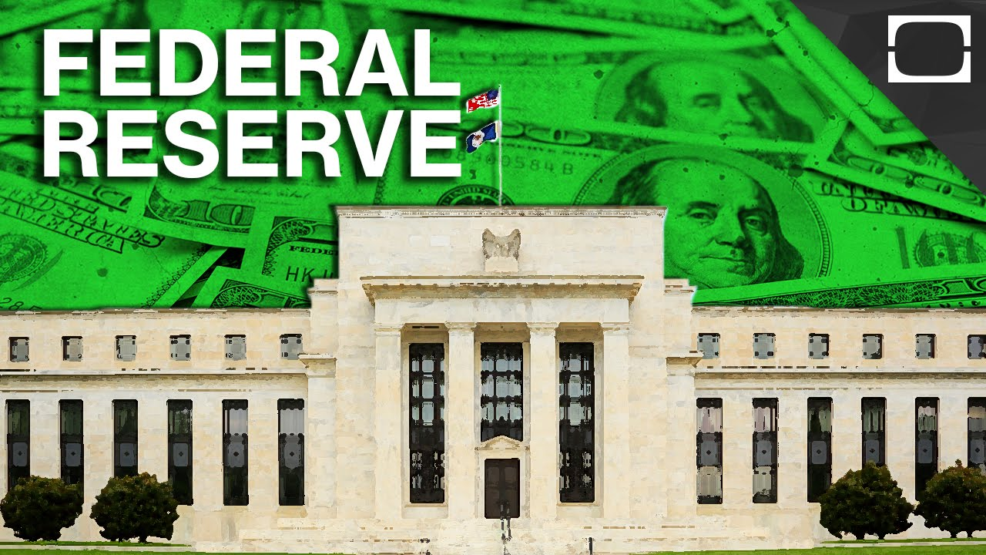

Slide 3
Why do we have it?
Notes:
https://www.youtube.com/watch?v=OQEWVDZme4A

Slide 4
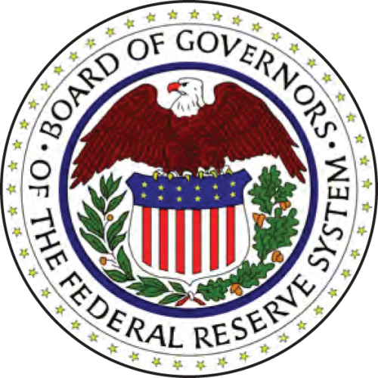
What is the Fed?
Central bank of the United States
Established in 1913
Purpose is to ensure a stable economy for the nation
Notes:
What is the Fed?
The Federal Reserve is the central bank of the United States and its purpose is to help ensure a stable economy for the nation.
Established as a result of the Federal Reserve Act, signed in 1913.
Receives no congressionally appropriated funds. Its operations are financed primarily from the interest earned on the U.S. government securities it acquires in the course of its monetary policy actions.
Another major source of income is derived from the fees received for certain services provided to depository institutions.
After payment of certain expenses, all the net earnings of the Federal Reserve Banks are transferred to the U.S. Treasury. In 2004, for example, the Fed paid approximately $18.1 billion to the U.S. Treasury.

Slide 5
Roles & Responsibilities
Conduct the nation’s monetary policy
Supervise and regulate banking institutions
Operate a nationwide payments system
Notes:
The responsibilities of the Federal Reserve System as a whole fall into the following three general areas:
Conducting the nation’s monetary policy
Supervising and regulating banking institutions
Operating a nationwide payment system.

Slide 6
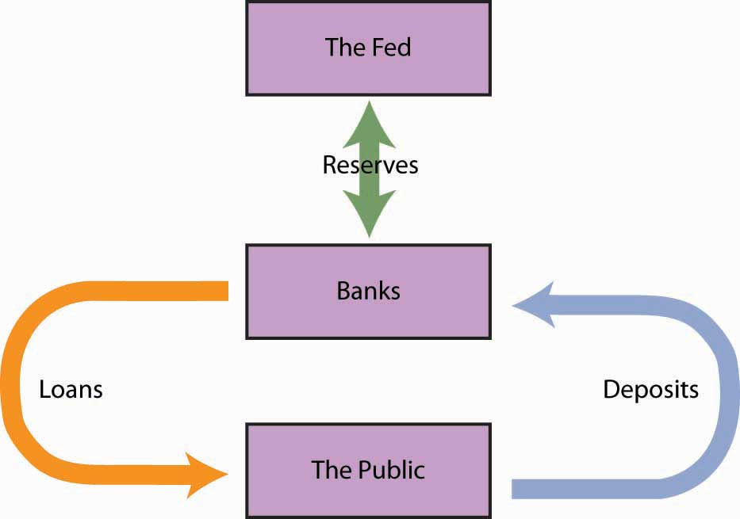

Slide 7
Federal Reserve System Structure
Board of Governors
12 Reserve Banks
Federal Open Market Committee (FOMC)
Notes:
The Board of Governors in Washington, D.C. oversees the activities of the twelve independently operated District Reserve Banks across the country.
Each of the 12 Federal Reserve Banks is separately incorporated with a Board of Directors. The District Federal Reserve Banks, along with their 25 branches, are located in major cities across the country, giving the System a strong grass-roots foundation.
The Federal Open Market Committee (FOMC) is the chief policymaking body of the Federal Reserve System.

Slide 8
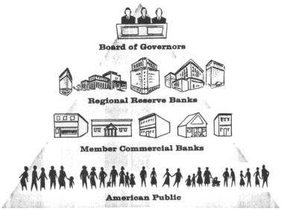

Slide 9
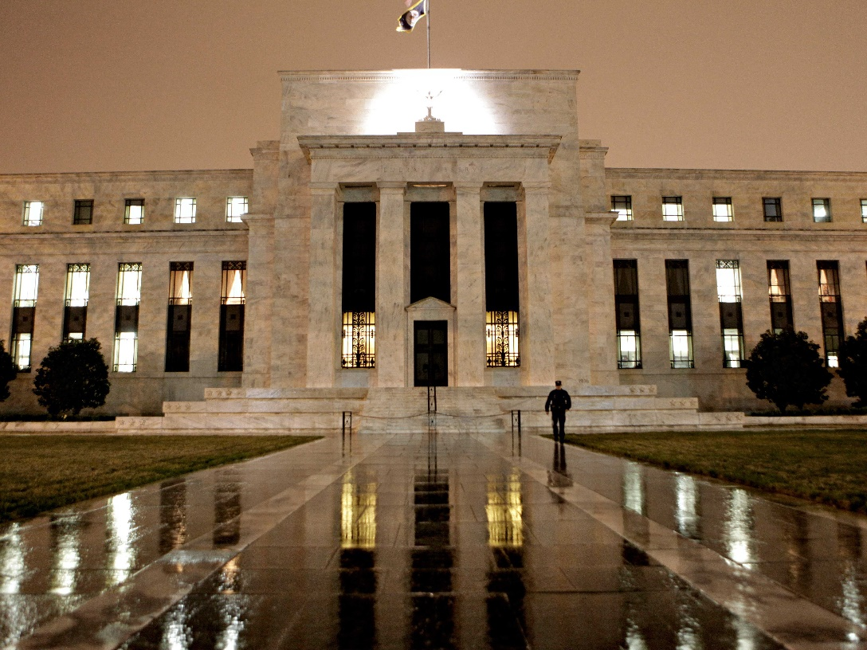
Board of Governors
Seven members
Appointed by the president
Confirmed by the Senate
Serve staggered 14-year terms
Notes:
Seven members (governors) of the Federal Reserve Board are appointed by the President and subject to approval by the Senate.
Structure provides for public accountability in the System, but because these governors serve staggered 14-year terms, the Board is insulated somewhat from short-term political pressure. Not one president can load the Board with candidates who will further a political agenda.
The work of the Board includes:
coordinating the activities of the regional Reserve Banks,
analyzing domestic and international economic issues,
exercising broad responsibility in the nation’s payments system, and
administering laws regarding consumer credit protection.

Slide 10
Board of Governors (cont’d)
Work includes
Administering consumer credit protection laws
Authorizing changes in banks’ reserve requirements
Supervising Fed member banks and other financial entities
Authorizing changes in the Fed’s discount rate
Notes:
Seven members (governors) of the Federal Reserve Board are appointed by the President and subject to approval by the Senate.
Structure provides for public accountability in the System, but because these governors serve staggered 14-year terms, the Board is insulated somewhat from short-term political pressure. Not one president can load the Board with candidates who will further a political agenda.
The work of the Board includes:
coordinating the activities of the regional Reserve Banks,
analyzing domestic and international economic issues,
exercising broad responsibility in the nation’s payments system, and
administering laws regarding consumer credit protection.

Slide 11
Janet Yellen – Fed Chair
Nominated in 2014
# 3 most powerful woman in the World (Forbes)

Slide 12
Where is my Fed?
Notes:
Reserve Banks are the decentralized components that carry out the Fed’s policies and activities at the regional level.
Each bank is identified with a corresponding letter and number to identify Districts.
There are several Divisions within the Fed that carry out its mandated responsibilities: Supervision & Regulation, Financial Services and Research.

Slide 13
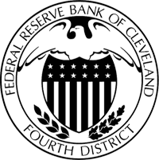
4th district

Slide 14
Federal Reserve Banks
Operate a nationwide payments system
Distribute the nation’s currency and coin
Supervise and regulate member banks
Contribute to monetary policymaking
Notes:
The Supervision & Regulation Division exists to promote the safety and soundness of the banking system, foster stability in financial markets, and ensure compliance with applicable laws and regulations.
One of four federal regulatory agencies:
Office of the Comptroller of the Currency (OCC)
Federal Deposit Insurance Corporation (FDIC),
Office of Thrift Supervision (OTS)
Has oversight of bank holding companies and state-chartered banks that are members of the Federal Reserve System; examines the health of banks; analyzes proposed mergers and acquisitions of banks; and monitors banks’ management, capital levels, and quality of assets.
Plays a major role in international banking activities
overseeing U.S. banking organizations that conduct operations abroad;
authorizing the establishment of foreign bank branches in the U.S.;
establishing supervisory policy and practices regarding foreign lending of member banks.
Responsible for implementing consumer protection laws, which cover almost all financial transactions involving consumers, including ATMs, credit cards, checking and savings accounts, and loans.

Slide 15
Supervision & Regulation
Promote safety
FDIC
Ensure compliance with laws and regulations
Oversee international banking interests
Administer consumer credit protection laws
Notes:
The Supervision & Regulation Division exists to promote the safety and soundness of the banking system, foster stability in financial markets, and ensure compliance with applicable laws and regulations.
One of four federal regulatory agencies:
Office of the Comptroller of the Currency (OCC)
Federal Deposit Insurance Corporation (FDIC),
Office of Thrift Supervision (OTS)
Has oversight of bank holding companies and state-chartered banks that are members of the Federal Reserve System; examines the health of banks; analyzes proposed mergers and acquisitions of banks; and monitors banks’ management, capital levels, and quality of assets.
Plays a major role in international banking activities
overseeing U.S. banking organizations that conduct operations abroad;
authorizing the establishment of foreign bank branches in the U.S.;
establishing supervisory policy and practices regarding foreign lending of member banks.
Responsible for implementing consumer protection laws, which cover almost all financial transactions involving consumers, including ATMs, credit cards, checking and savings accounts, and loans.

Slide 16
Financial Services
Supply currency and coin to banking institutions
Clear more than one-third of nation’s checks
Transfer funds electronically
Notes:
The Financial Services Division is the operational area of the Bank.
Responsible for supplying currency and coin to financial institutions. The Fed orders new currency from the Bureau of Engraving & Printing, and coin from the U.S. Mint, and is responsible for destroying unfit currency.
As a provider of check clearing services, the Fed processes about 1/3 of all of the checks written in the U.S.
The Automated Clearinghouse (or ACH) is an electronic form of payments processing, which you may be familiar with if you work and get your pay deposited directly into your account.
Another example of electronic payments processing is FedWire, which is utilized primarily by financial institutions to transfer very large sums of money electronically.
The Fed acts as the fiscal agent (bank) for the United States Treasury.

Slide 17
Federal Open Market Committee
Sets and directs U.S. monetary policy
Seven governors
Five presidents (New York and four others on a rotating basis)
Notes:
The Federal Open Market Committee (FOMC) is the primary group responsible for formulating and implementing monetary policy.
Seven Fed governors and the twelve Bank Presidents participate in the economic discussions at each meeting, with the Reserve Bank Presidents bringing to the table regional economic news gleaned from their local boards of directors and staff economists.
Every president and each of the governors are given an opportunity to present their opinions.
Twelve of the 19 members vote at the meetings—all seven governors and five of the Reserve Bank Presidents, with the president of the New York Fed always a voting member, because Open Market Operations are carried out at the trading desk of the New York Fed. The other four voting positions rotate yearly among the remaining eleven Reserve Bank presidents.
Policy changes are decided by consensus and are announced immediately following each meeting.

Slide 18
Goals of Monetary Policy
Full
Employment
Stable Prices
Sustainable Economic Growth
Notes:
Monetary policy is designed to effectively promote the goals of maximum employment, stable prices, and sustainable economic growth.
The Fed is consistently striving for a balance between oftentimes conflicting goals of monetary policy
For example, if the economy is growing at too rapid a pace, the Fed may dampen that growth by influencing interest rates to rise, which may have the effect of putting some people out of work—a direct challenge to the goal of maximum employment.

Slide 19
Key Tools of Monetary Policy
Discount Rate
The interest rate charged by the Federal Reserve to banks that borrow on a short-term basis.
Reserve Requirements
The amount of money banks must keep on reserve at the Fed.
Treasury Bonds
If they sell there is more money in circulation, if they buy there is less.
Notes:
The tools the Fed utilizes to influence the economy (or affect the amount of funds in the banking system) are:
Discount Rate:
Rate of interest charged to banks that need to borrow from the Fed to cover temporary deposit drains (short-term “discount window” loans).
Reserve Requirements:
Portions of deposits that banks must hold in reserve, either in their vaults or on deposit at a Reserve bank.
Federal Open Market Operations:
The most frequently used and most flexible tool is that of Open Market Operations, which involves the buying and selling of U.S. government securities. This tool is directed by the FOMC and carried out at the domestic trading desk at the Federal Reserve Bank of New York

Slide 20
Key Federal Reserve Interest Rates
Federal Funds Rate
The market-based interest rate which banks charge each other on overnight loans of their reserve balances held at the Fed.
Notes:
Discount Rate
Applies to loans made directly to commercial banks from the Federal Reserve System
Typically set at one percentage point above the Federal Funds Rate – incentive not to borrow from the Lender of Last Resort
Federal Funds Rate
The lowest of short-term market interest rates which banks charge each other on overnight loans. The Fed achieves this rate through Open Market Operations.

Slide 21
Effects of Low Interest Rates
They stimulate the economy because there is more money available to lend.
Why does the Fed lower interest rates?
If inflation is in check, lower rates stimulate economic activity.
Notes:
Impact of Lowering Rates:
The cost of borrowing money goes down.
Induced consumer spending increases economic activity.
Low interest rates cut the cost of capital for businesses and improve profit margins and encourages expansion.

Slide 22
Effects of High Interest Rates
It fights inflation.
Consumers pay more to borrow money, dampening spending.
Businesses have difficulty borrowing; unemployment rises.
Notes:
The Fed generally raises rates as an effective way to quell inflation (a sustained rise in the general price level).
Inflation means that your money is worth less
Impact of Raising Rates:
Businesses have difficulty in obtaining loans for expansion; unemployment rises
Consumers will pay higher interest rates on credit cards and mortgages, which can cool spending.

Slide 25
Read the article…
Is this an optimistic view of the economy?
What is the “mandate” given to the FED?
What is the inflation rate the committee aims to be at?
What are they going to do with treasury bonds?
How many votes were there at the FOMC?

Slide 26
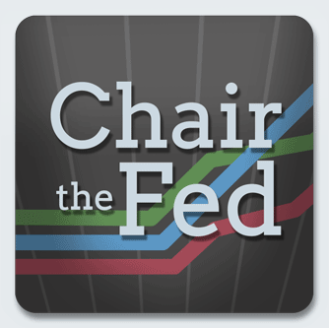
SIMULATION
Go to Chapter five on the class webpage.
Click on the image.
Read the “Your job” descriptions before you play.
Complete the worksheet provided and answer the questions on the reverse when finished.

Slide 27
Review
What are the three main roles of the Federal Reserve System?
Where is your Fed?
What are the goals of monetary policy?
What happens when the Fed lowers interest rates? Raises interest rates?
What is inflation? Why should it concern you?
What is the name of the Fed’s monetary policymaking body?
What is the discount rate? Federal funds rate?
Notes:
Answers:
Conducting the nation’s monetary policy, Supervising and regulating banking institutions, and operating a nationwide payment system.
Results will vary
Maximum employment, price stability, sustainable economic growth
Lower rates induce economic activity; higher rates calm inflation, slows down spending
Inflation is a sustained increase in the general price level; inflation is a concern because it means your money is worth less over time.
The Federal Open Market Committee (FOMC)
Discount Rate – the rate of interest charged to banks who borrow money from the Federal Reserve; Fed Funds Rate – the rate of interest banks charge each other to borrow money.

